Slide 1

Energy Data Analytics Project Presentation
Generating Synthetic Energy Data using Generative Modelling
Team Members:
Siddharth S Desai
Jayadeep More
Maj. Abhishek Bhadouriya

Slide 2
Preview
Introduction
Dataset-1 Overview
Model used for synthetic data generation
Model 1: GAN
Model 2: C- GAN
Model 3: CTGAN
Model 4: TVAE
Inferences and Visualization
Re-trg of better models with different data set
Comparison and conclusion
References

Slide 3
Dataset Over-View
Residential Dataset of:
Air Conditioner
Fridge
Washing Machine
Laptop Computer
Iron
Kitchen Outlets
Television
Water Filter
Water Motor
From to May 24, 2013, at midnight UTC to August 24, 2013, at 07:39:56 UTC.
Interval of 1 second.
40 lac Rows of 1 second interval each.
8 columns.

Slide 4
W (Active Power/Work Done): Represents active power in watts. Positive values indicate power generation, and negative values reflect consumption or losses.
VAR (Reactive Power): Measures reactive power in Volt-Ampere Reactive (VAR). Indicates energy oscillations in the system.
VA (Apparent Power): Represents apparent power, the total combination of active and reactive power. Indicates the total power flow in the system.
f (Frequency): Denotes the frequency of the electrical supply (e.g., 50 Hz or 60 Hz). Fluctuations indicate deviations from the standard.
VLN (Voltage Line-to-Neutral): Measures the voltage between the line and neutral in the system. Indicates the electrical potential difference.
PF (Power Factor): A metric for energy efficiency, showing how effectively power is being used. Values closer to 1 indicate higher efficiency.
A (Current/Amperage): Represents the current flowing through the system in amperes. Positive values indicate energy flow, and negative values signify reverse flow or losses.
Dataset 1

Slide 5
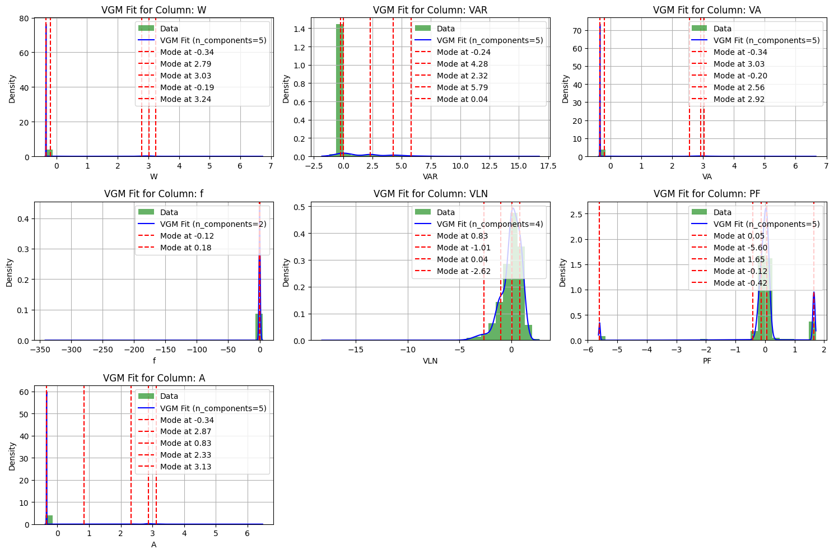
Visualize
Dataset
After
Std

Slide 6
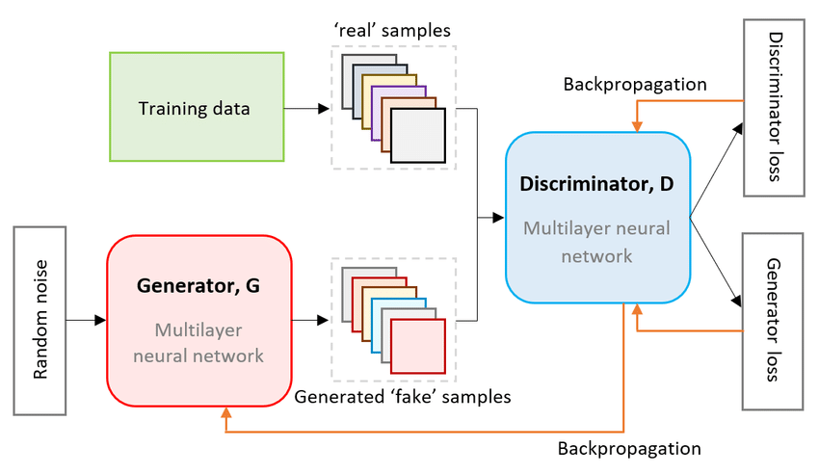
Model 1: GAN
https://www.researchgate.net/figure/Example-of-GAN-Architecture_fig1_356809414

Slide 7
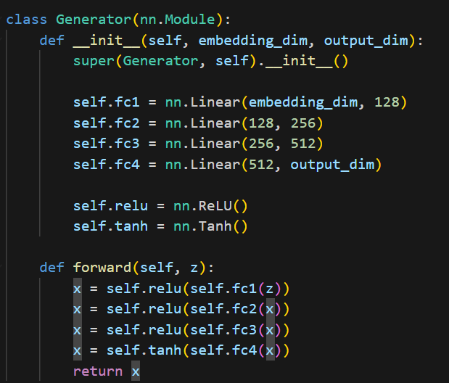
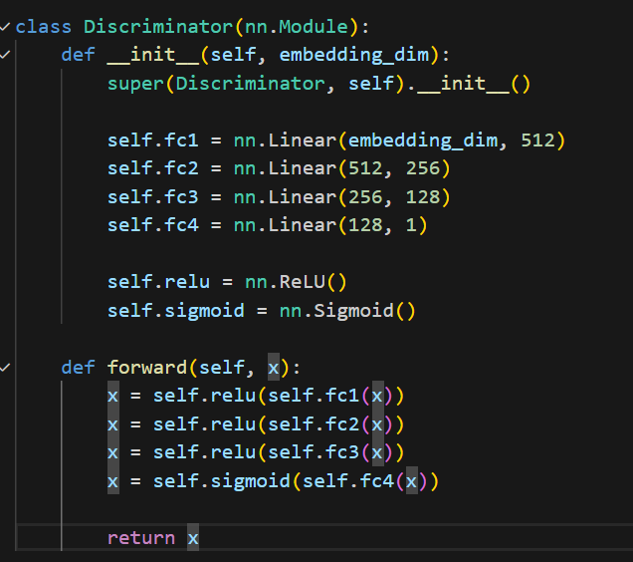
Our Architecture:
embed_dim = 100
op_dim = 7
n_epochs = 5000
lr = 0.0002
k=2
batch_size = 128

Slide 8
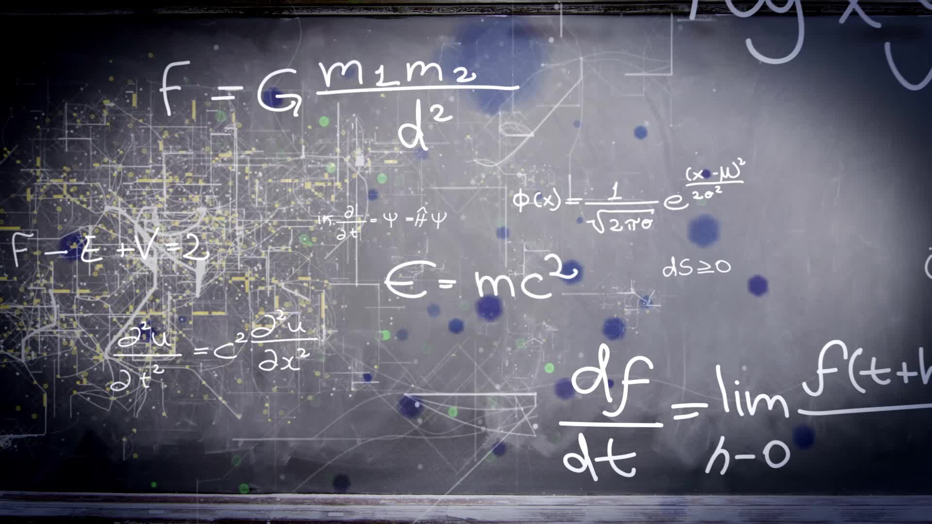
Inference and Visualization for Model 1:

Slide 9
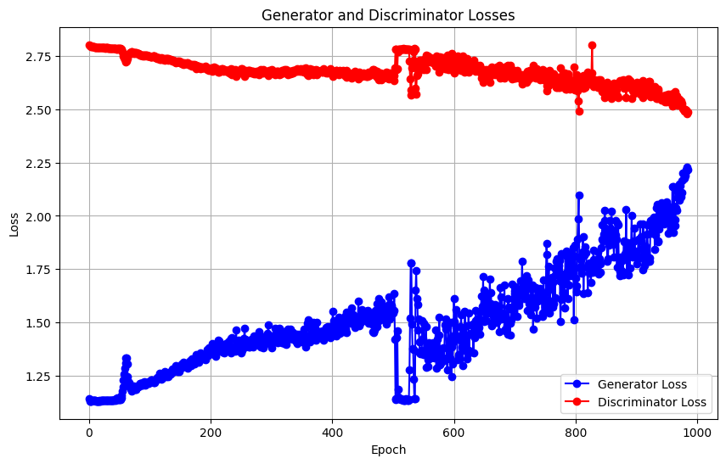
Loss Plot

Slide 10
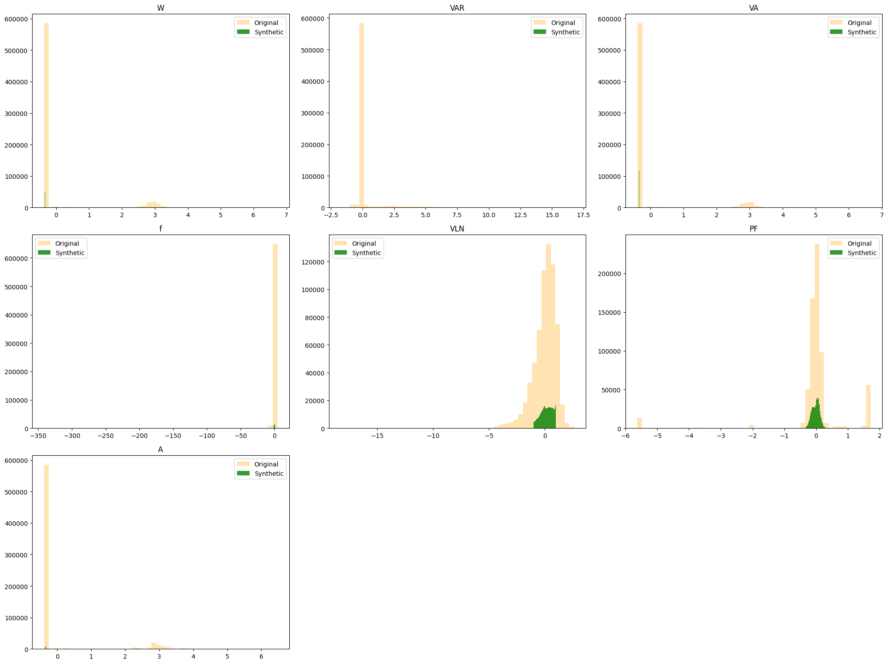
Histogram Plot

Slide 11
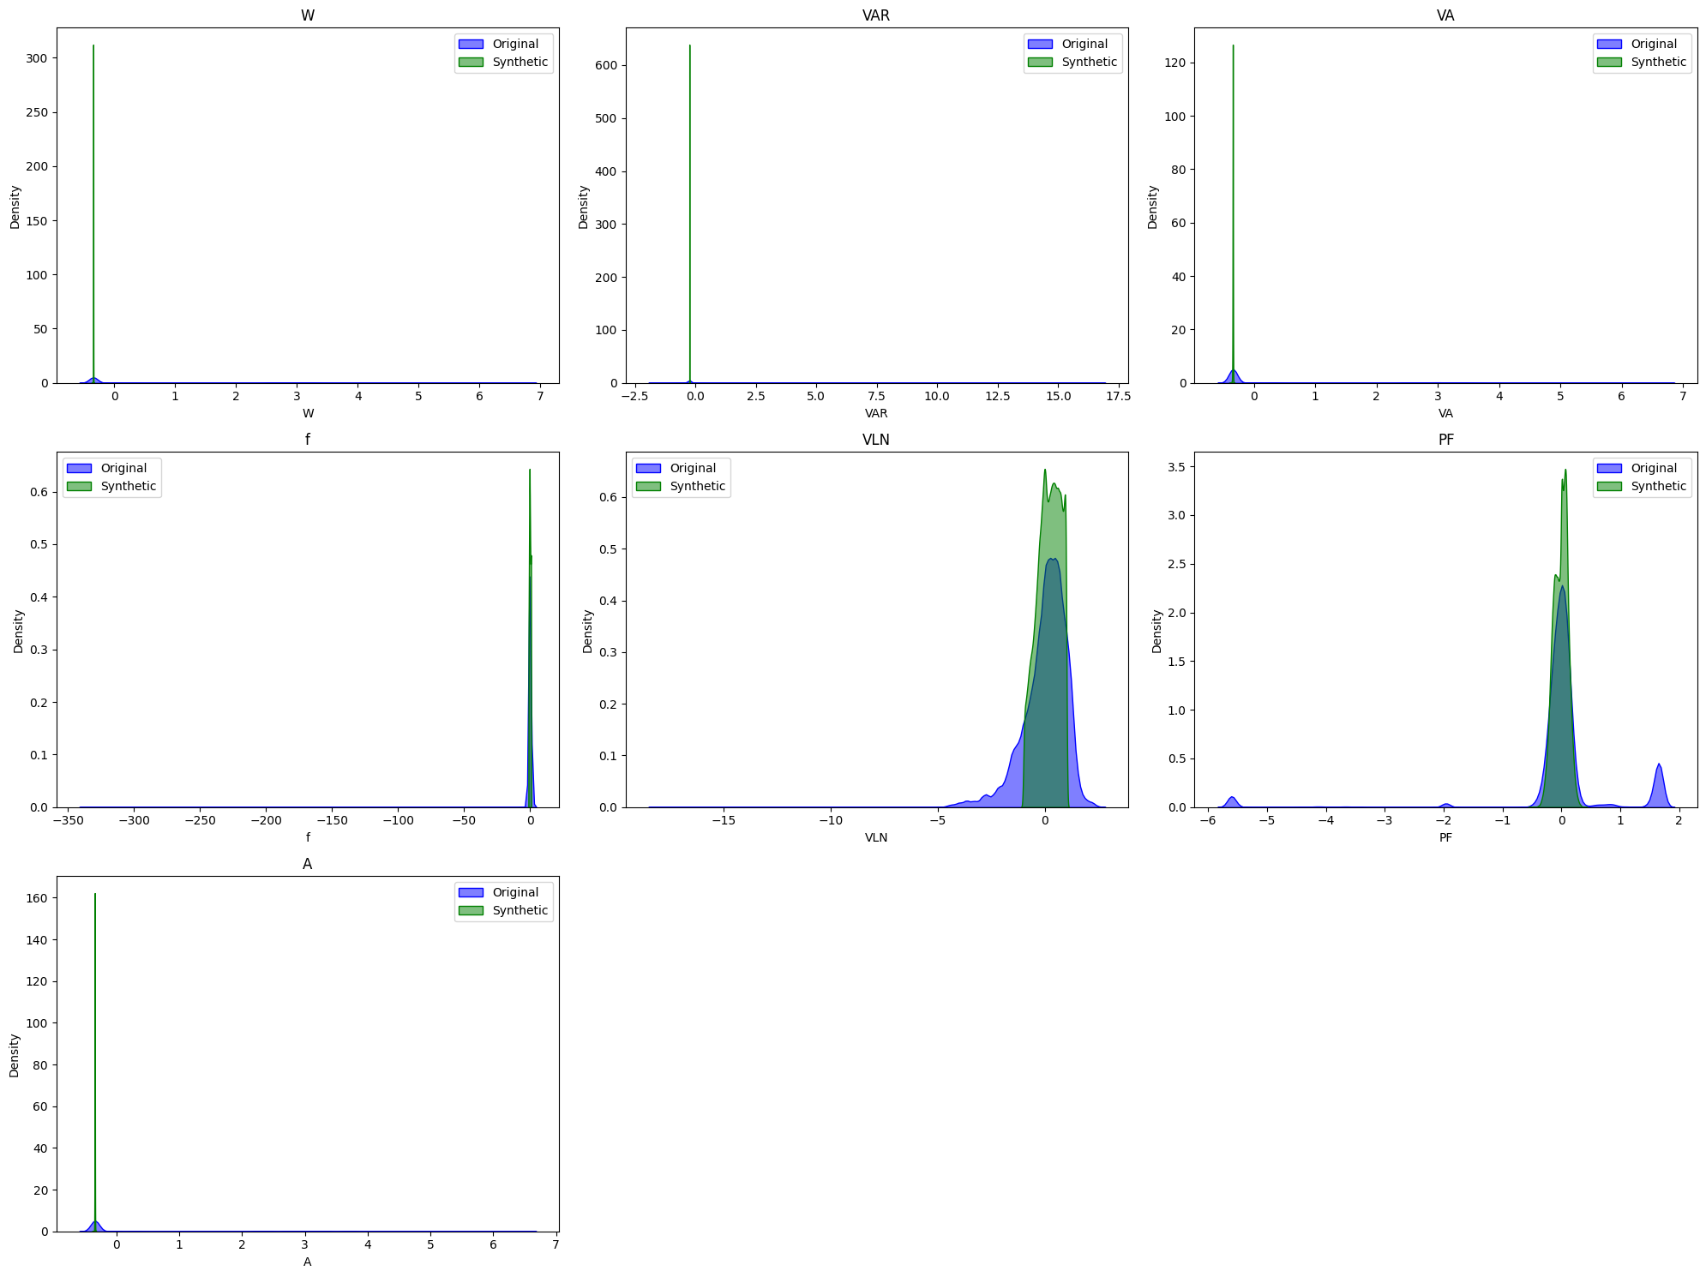
KDE Plot

Slide 12
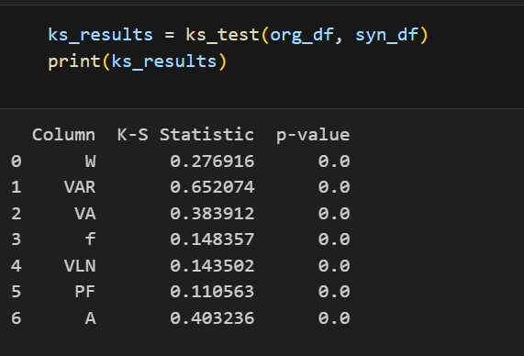
Statistical Test:
KS Test(Kolmogorov Smirnov)

Slide 13
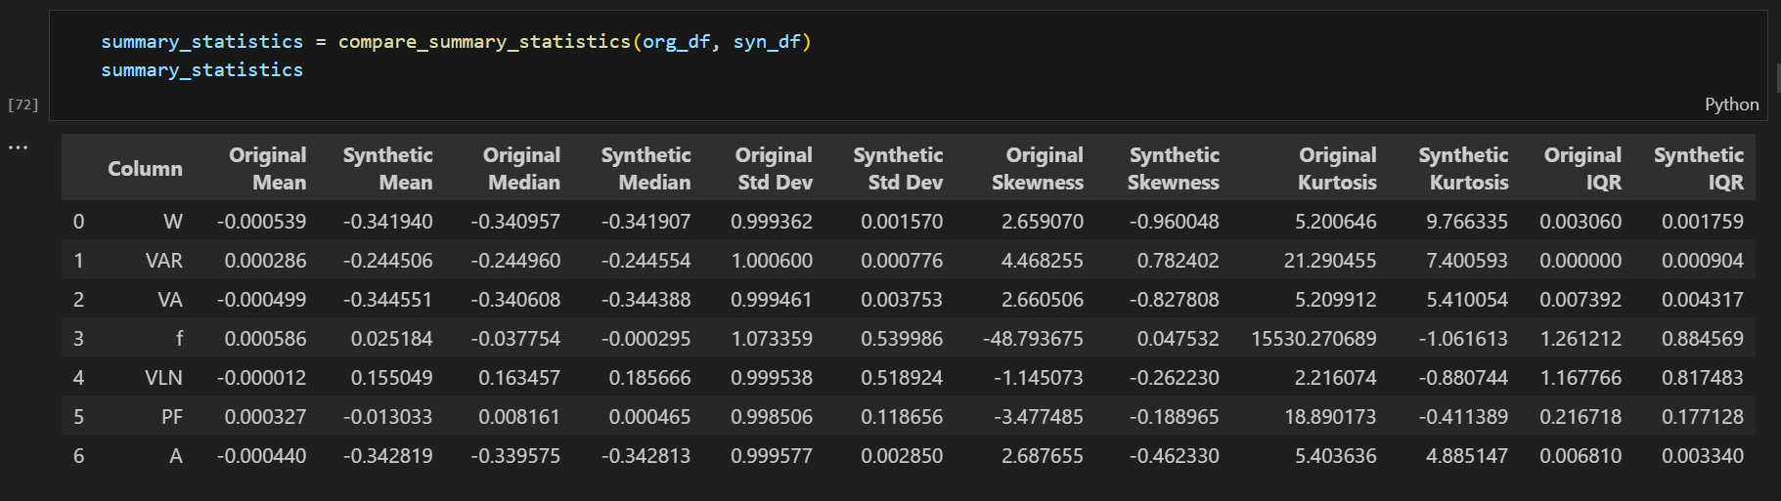
Summary Statistics Test:

Slide 14
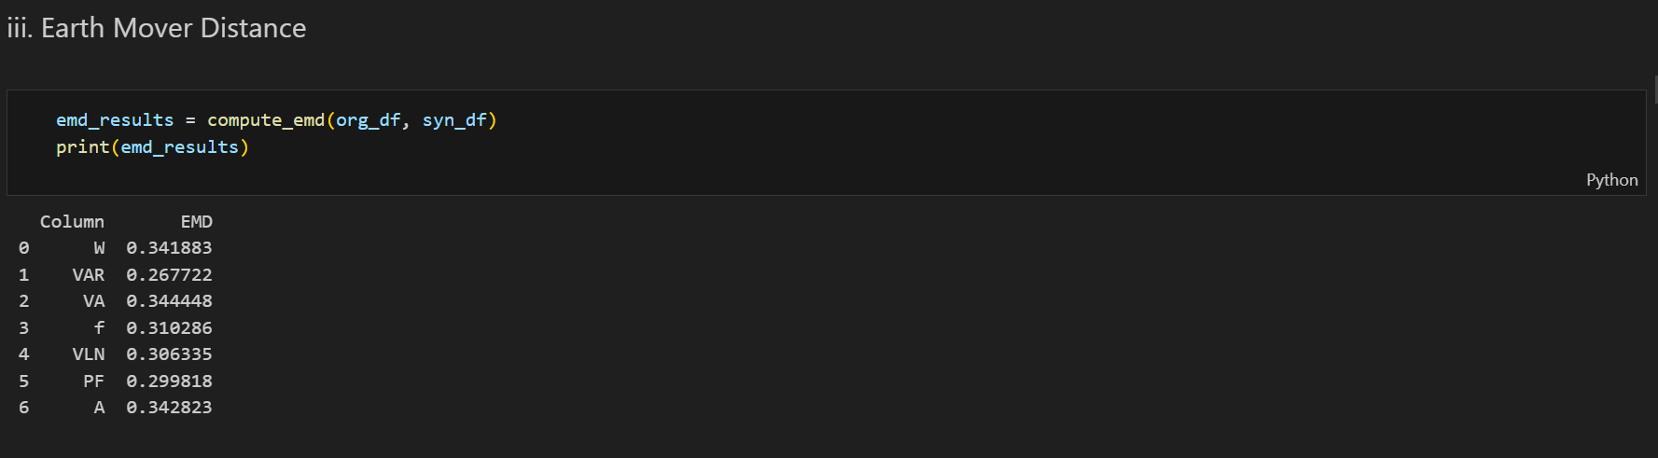
Earth Mover’s Distance :

Slide 15
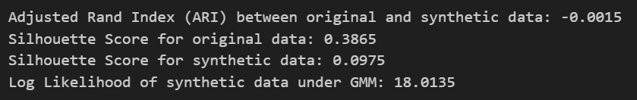
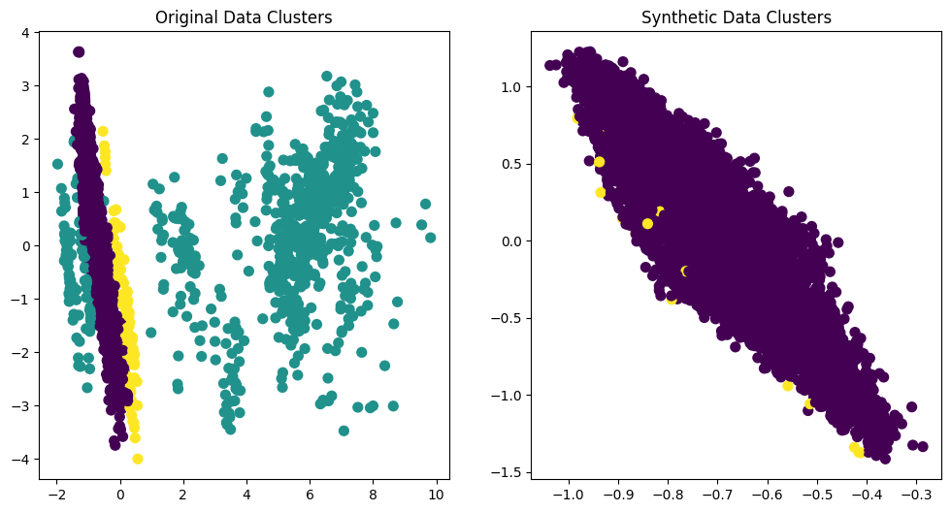
GMM Classifier :
For first 6000 Datapoints

Slide 16
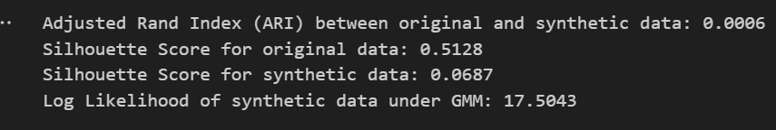
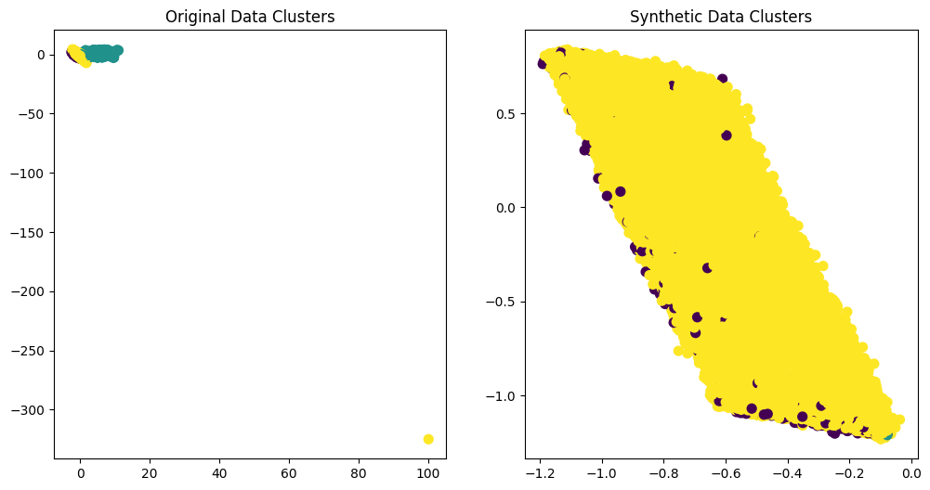
GMM Classifier :
For first 60k synthetic datapoints

Slide 17
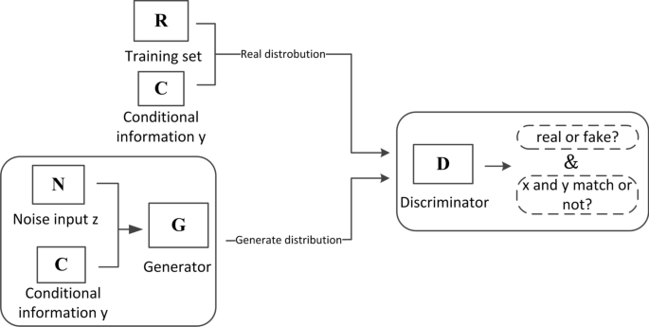
Model 2: C-GAN
https://jwcn-eurasipjournals.springeropen.com/articles/10.1186/s13638-021-01898-3

Slide 18
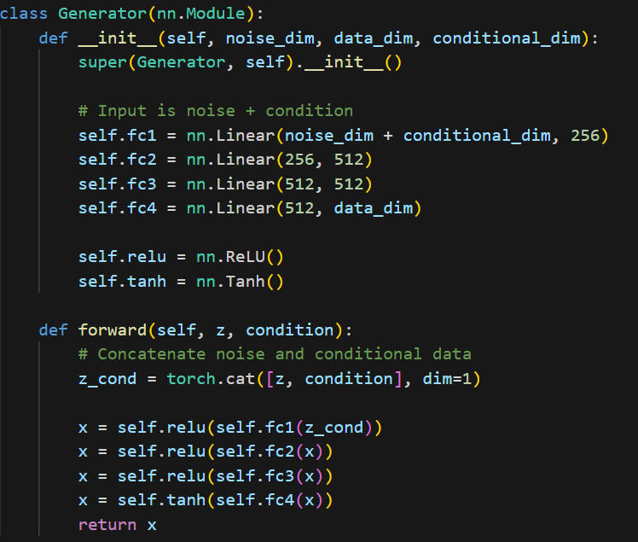
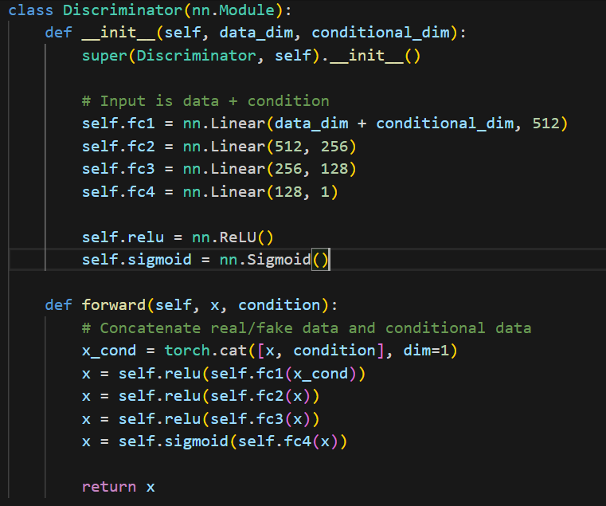
Our Architecture:
emb_dim = 100 c_dim = 1
op_dim=6 bs = 64
epochs = 100 lr_gen = 0.001
lr_disc = 0.001

Slide 19
Inference and Visualization for Model 2:

Slide 20
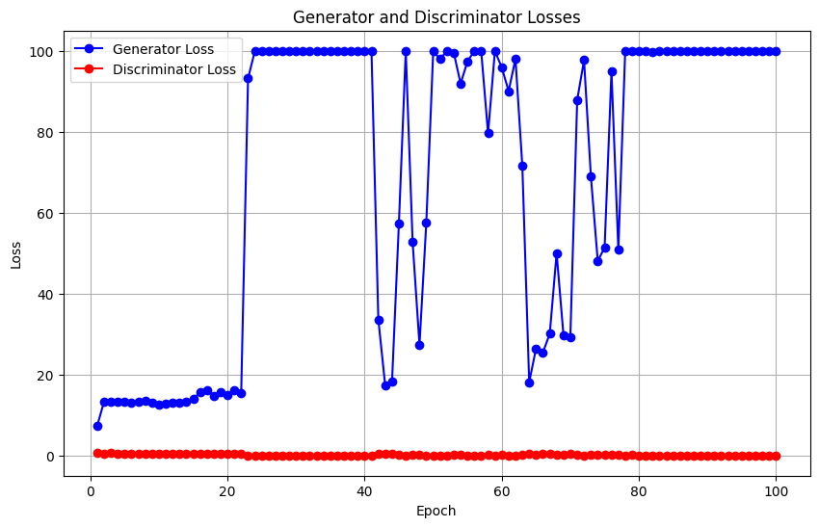
Loss Plot

Slide 21
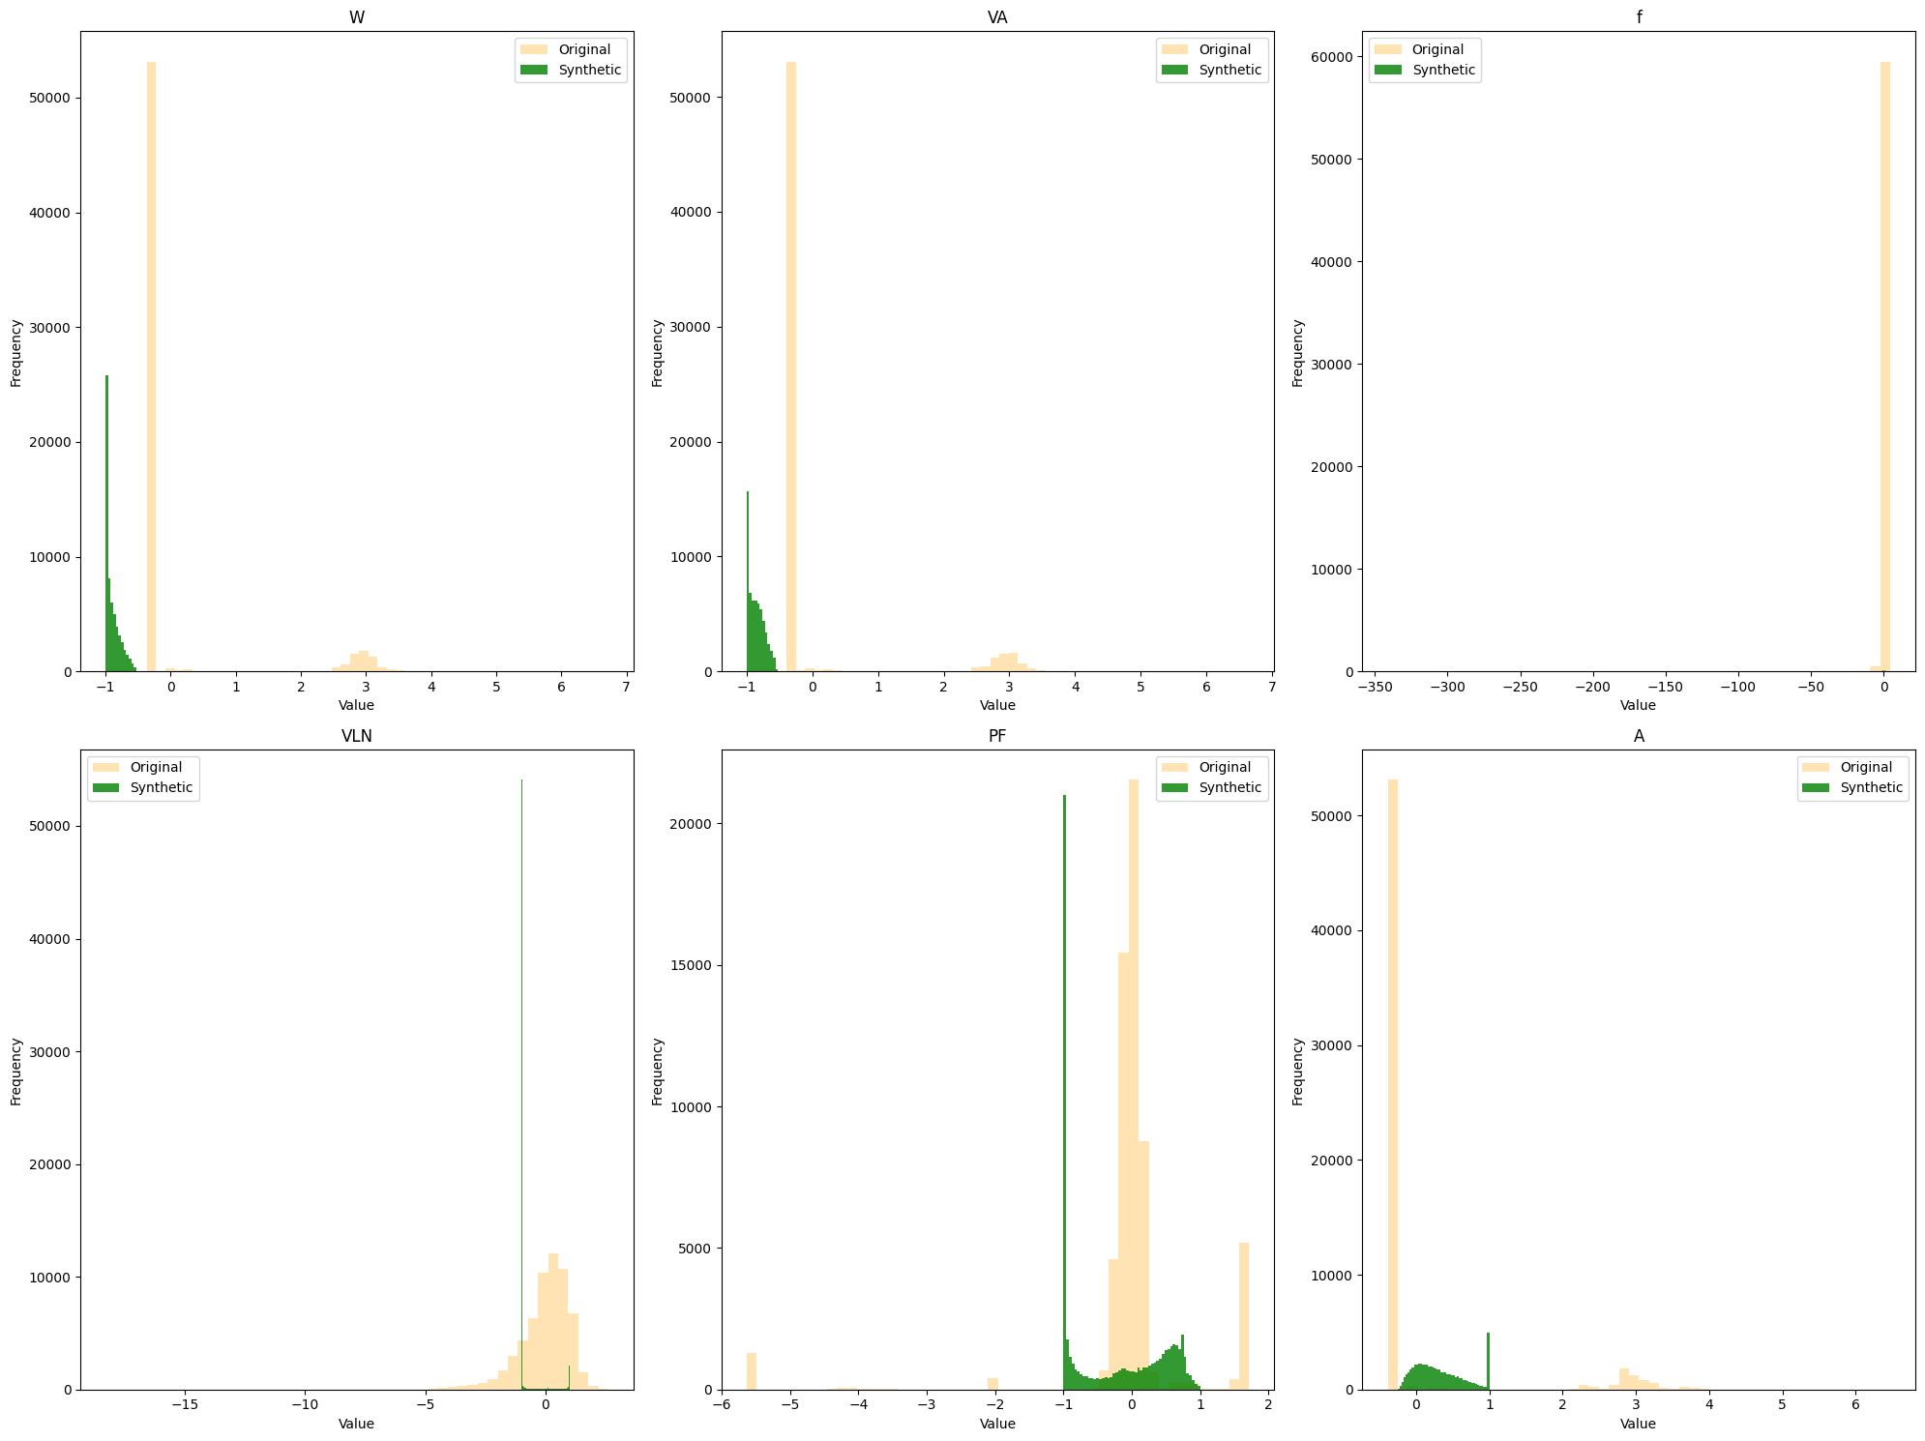
Histogram Plot

Slide 22
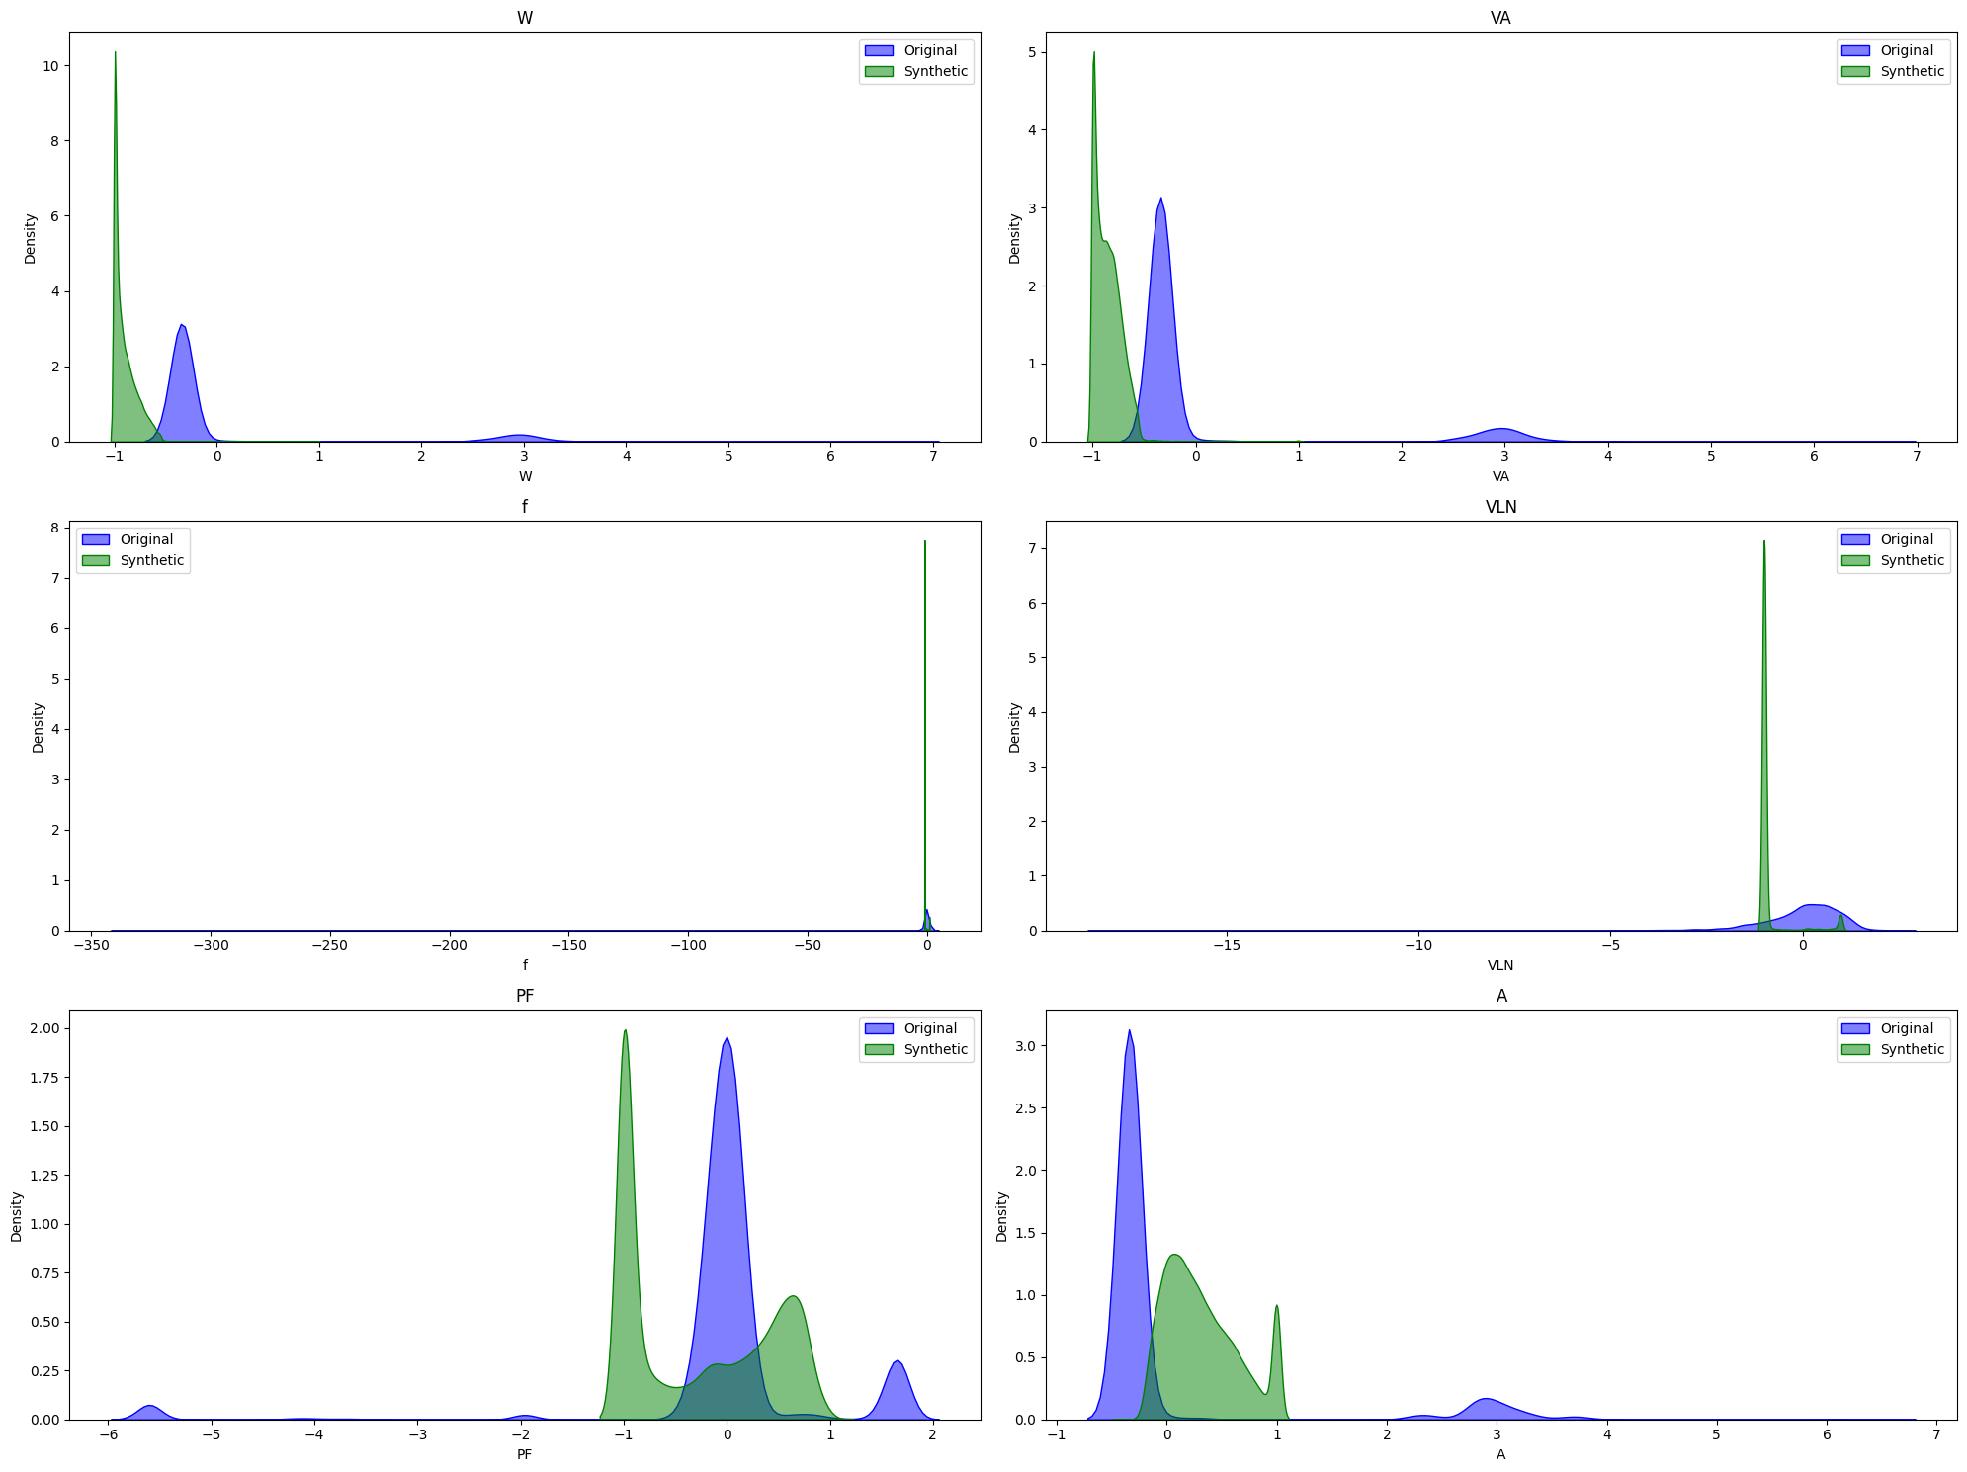
KDE Plot

Slide 23
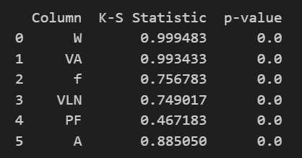
Statistical Test:
KS Test(Kolmogorov Smirnov)

Slide 24
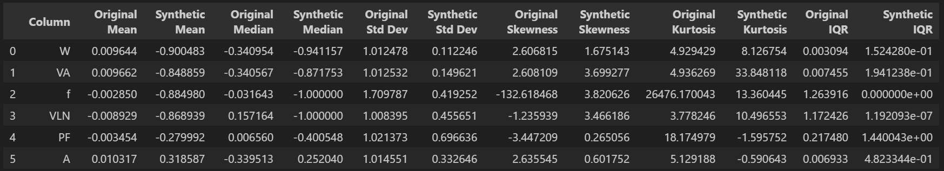
Summary Statistics Test:

Slide 25
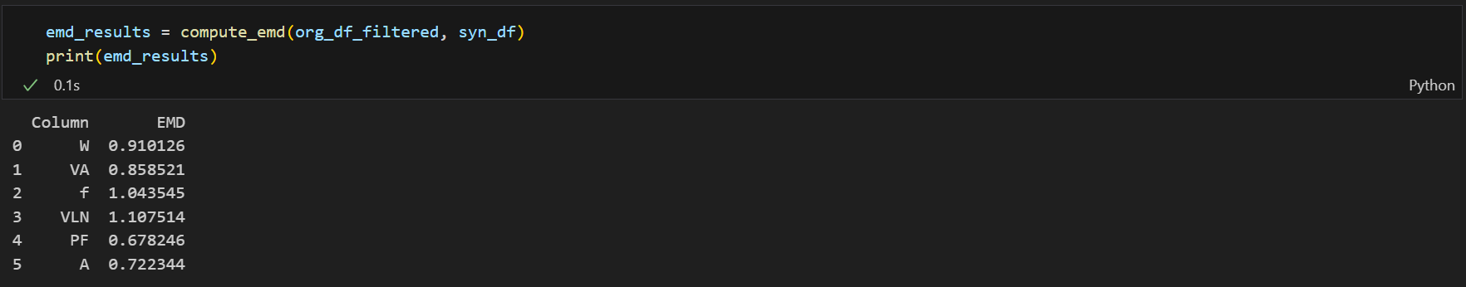
Earth Mover’s Distance :

Slide 26
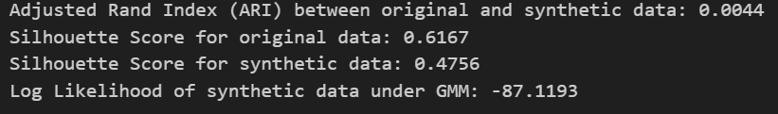
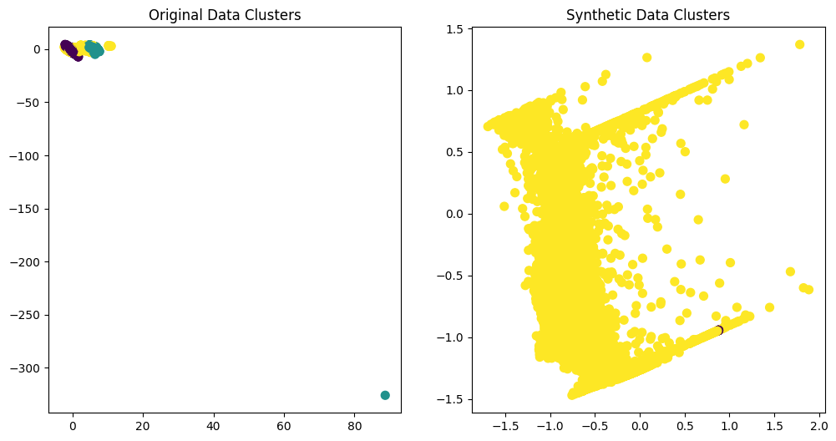
GMM Classifier :
1 Lac synthetic datapoints

Slide 27
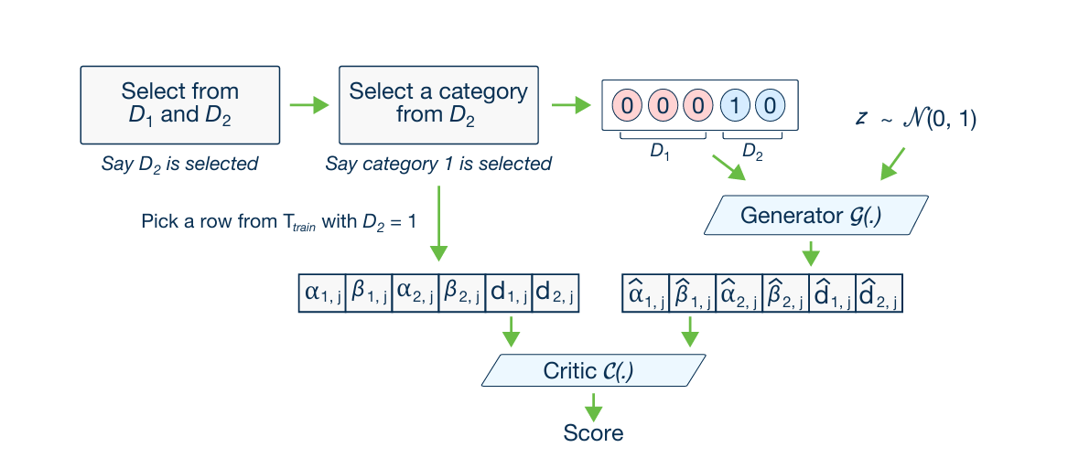
Model 3: CTGAN

Slide 28
Inference and Visualization for Model 3:

Slide 29
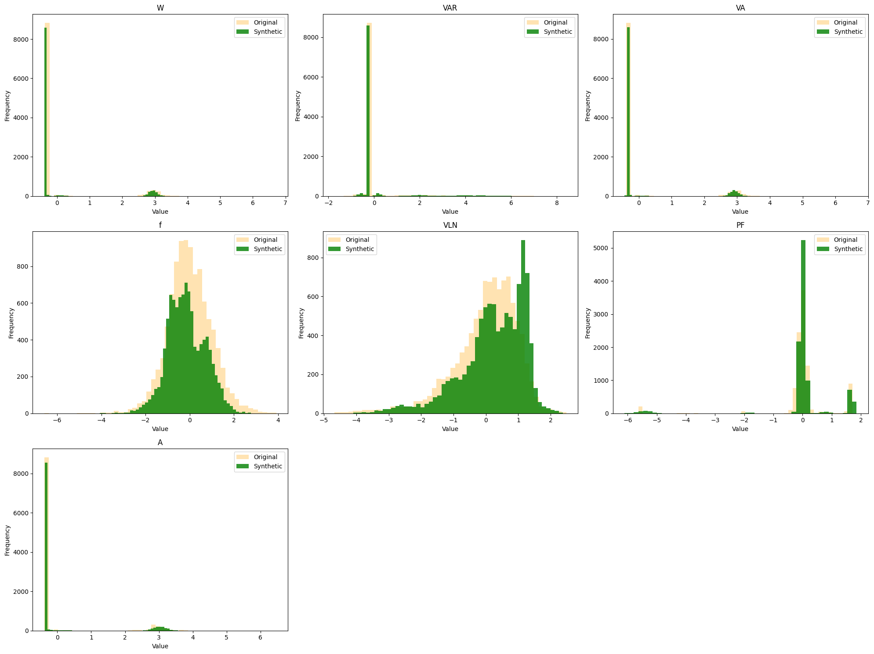
Histogram Plot

Slide 30
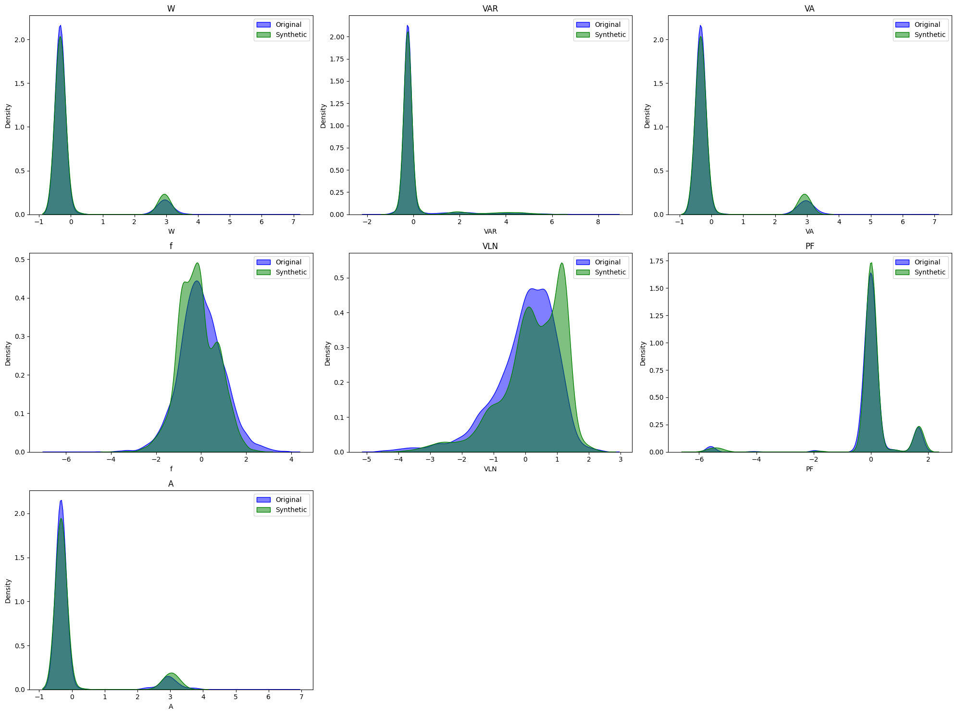
KDE Plot

Slide 31
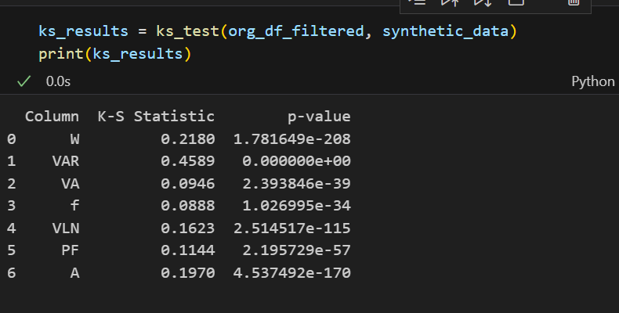
Statistical Test:
KS Test(Kolmogorov Smirnov)

Slide 32
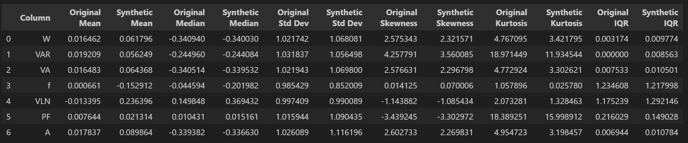
Summary Statistics Test:

Slide 33
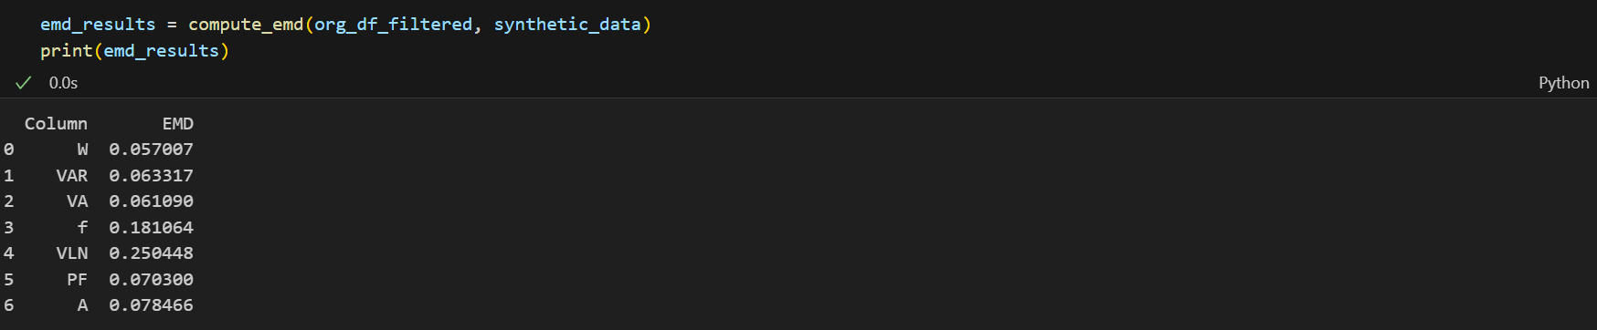
Earth Mover’s Distance :

Slide 34
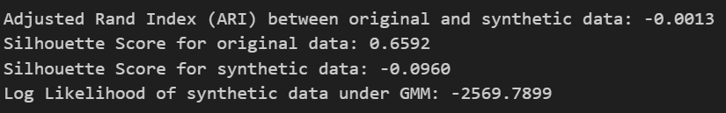
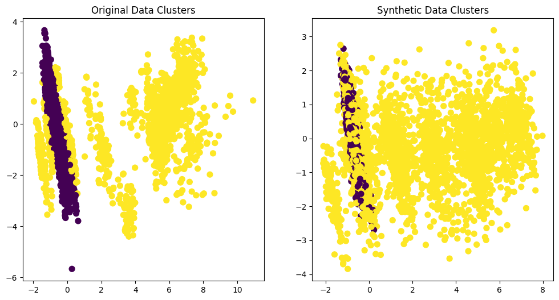
GMM Classifier :

Slide 35
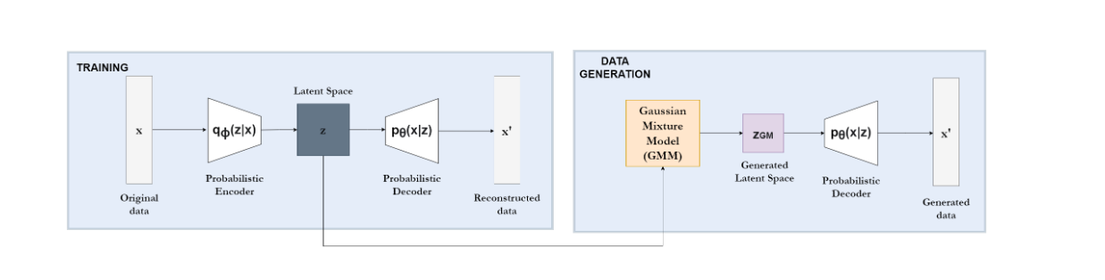
Model 4: TVAE

Slide 36
Inference and Visualization for Model 4:

Slide 37
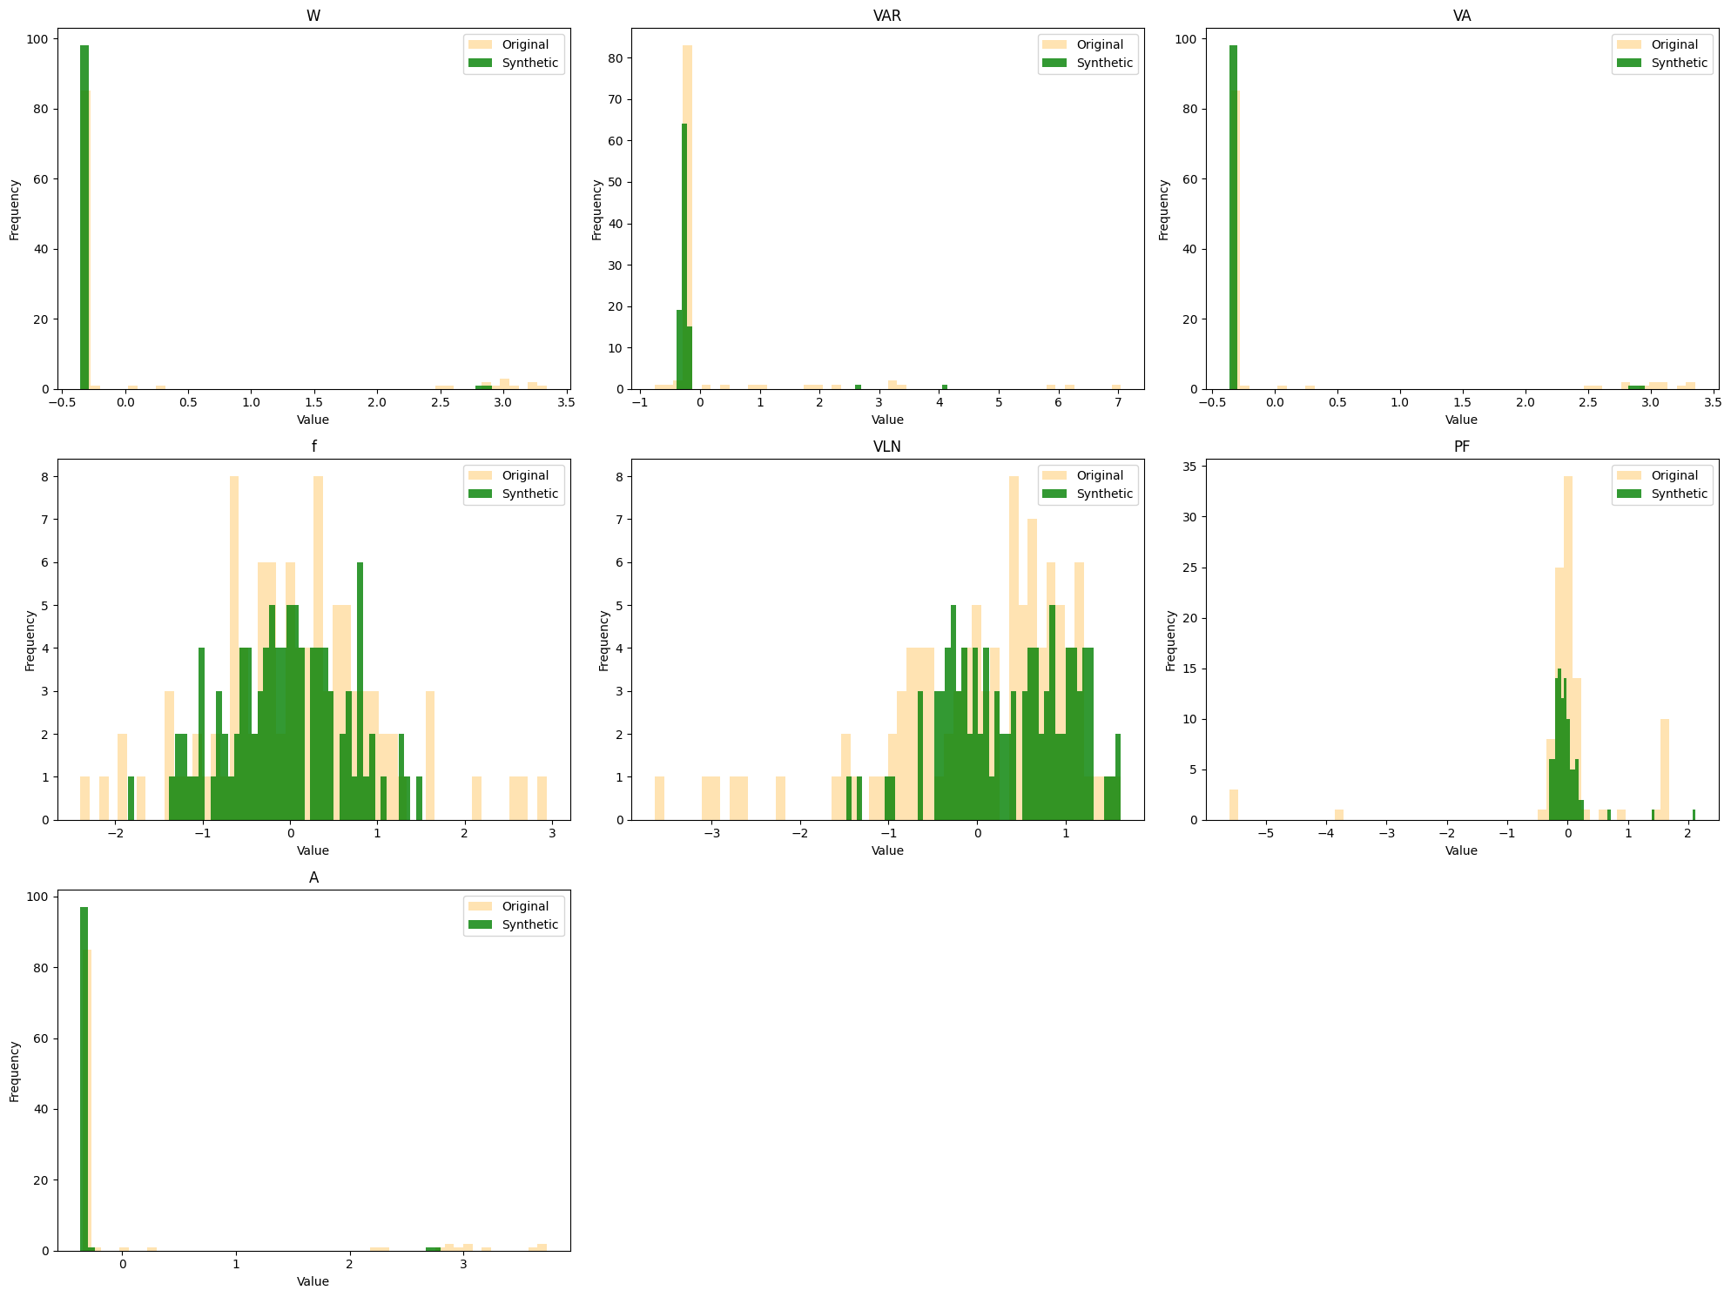
Histogram Plot

Slide 38
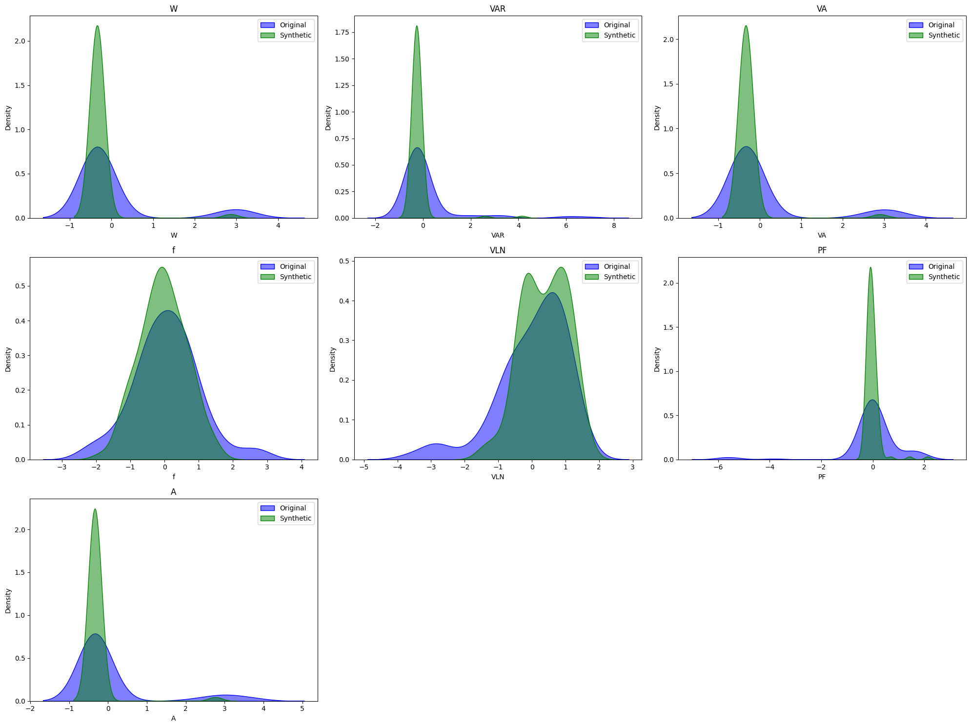
KDE Plot

Slide 39
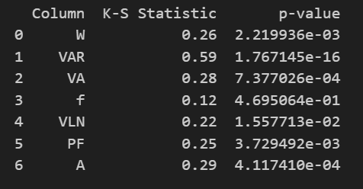
Statistical Test:
KS Test(Kolmogorov Smirnov)

Slide 40
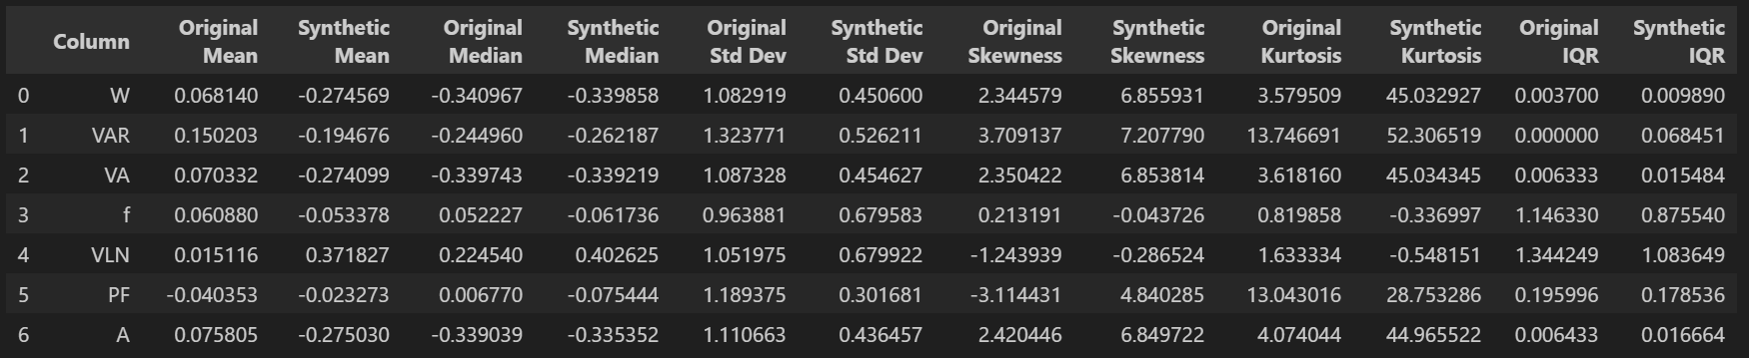
Summary Statistics Test:

Slide 41
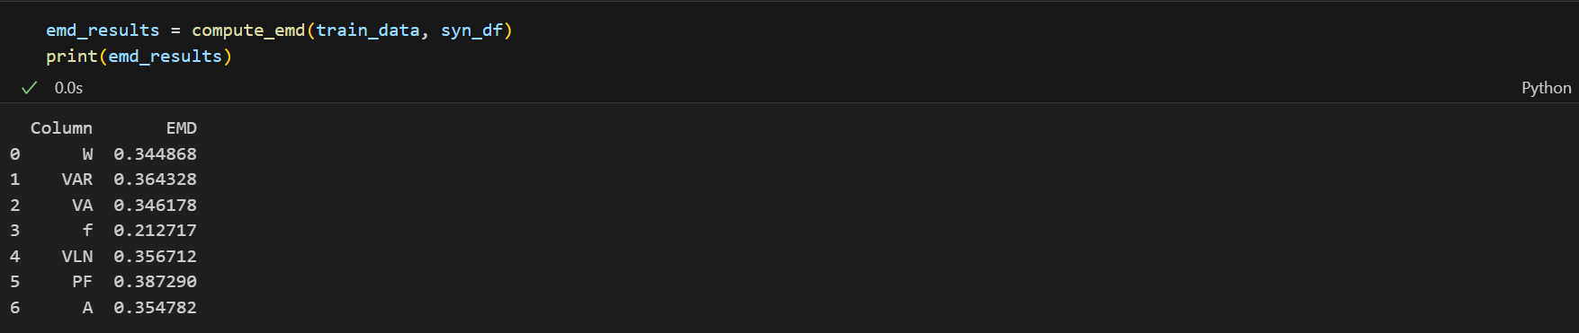
Earth Mover’s Distance :

Slide 42
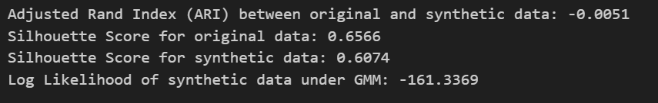
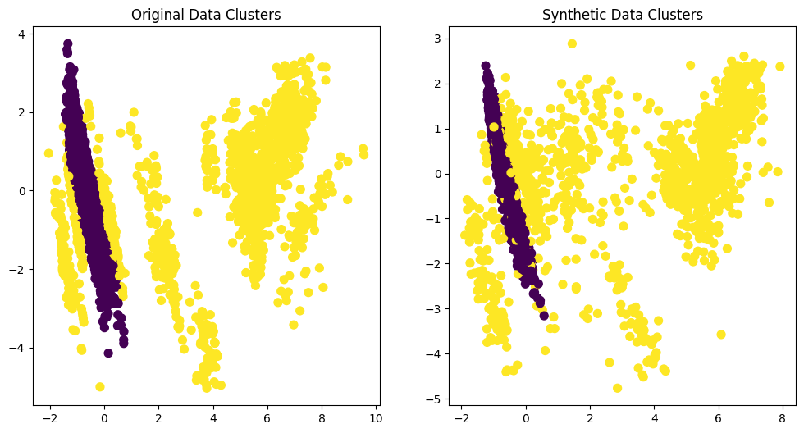
GMM Classifier :

Slide 43
Global_active_power: Total active power consumed by all household appliances in kilowatts (kW).
Global_reactive_power: Total reactive power consumed in the system in kilovolt-amperes reactive (kVAR).
Voltage: The electrical potential or voltage in volts (V) across the electrical grid.
Global_intensity: The total current intensity (in amperes) used by the household appliances.
Sub_metering_1: Energy consumption (in watt-hours) for a specific appliance, typically the kitchen.
Sub_metering_2: Energy consumption (in watt-hours) for another specific appliance, often the laundry.
Sub_metering_3: Energy consumption (in watt-hours) for a third appliance, such as the air conditioning system.
Dataset 2

Slide 44
Inference and Visualization for Model 3:

Slide 45
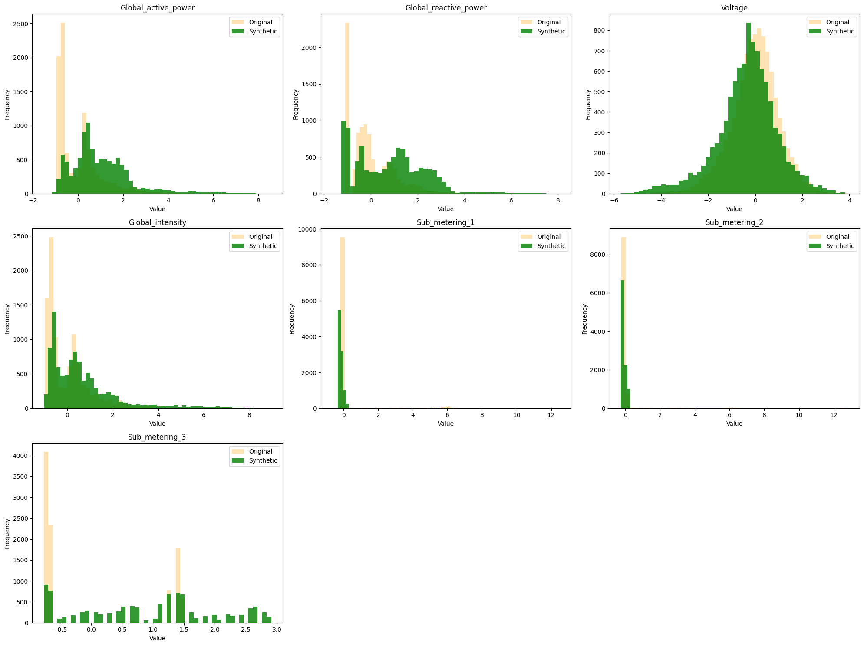
Histogram Plot

Slide 46
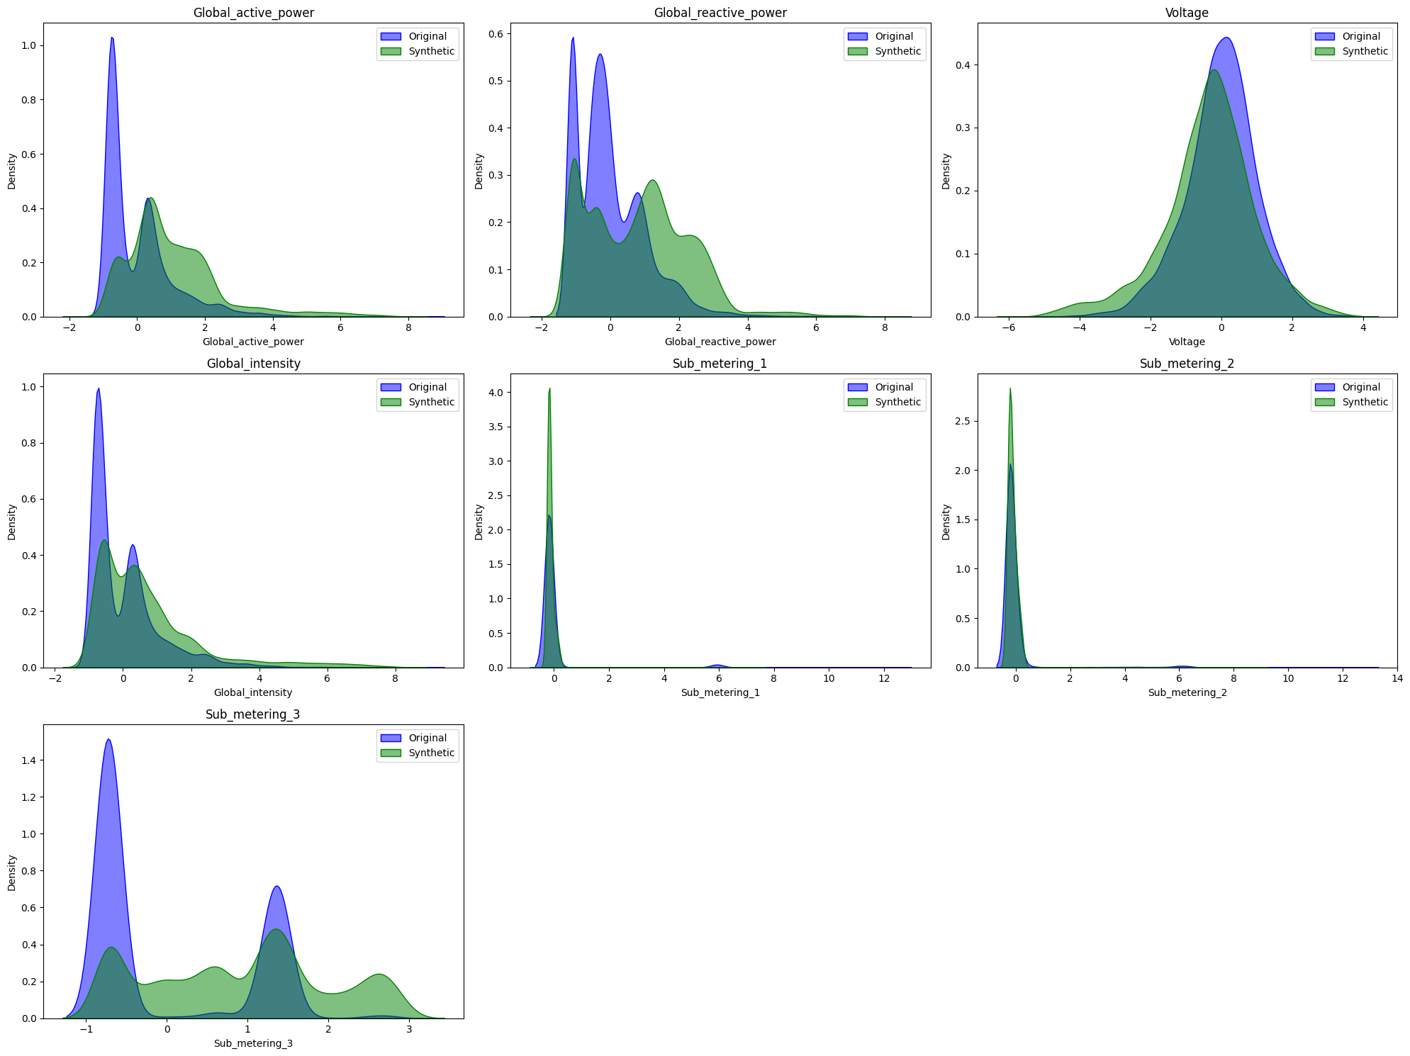
KDE Plot

Slide 47
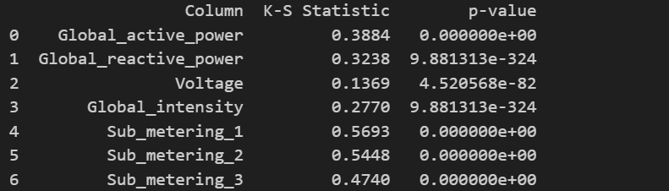
Statistical Test:
KS Test(Kolmogorov Smirnov)

Slide 48
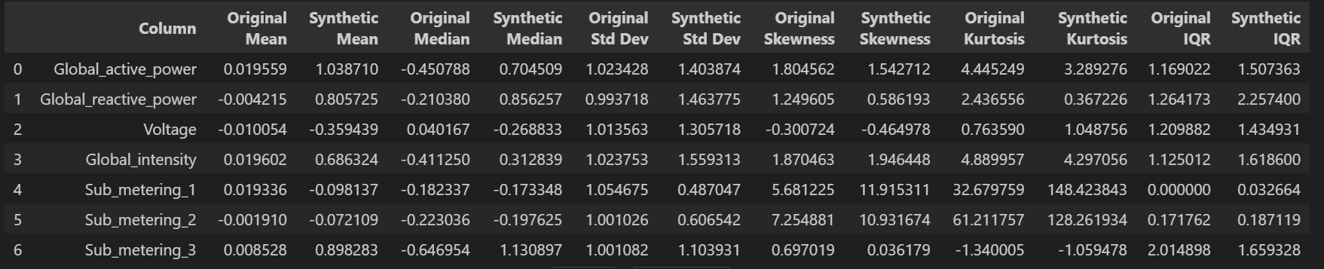
Summary Statistics Test:

Slide 49
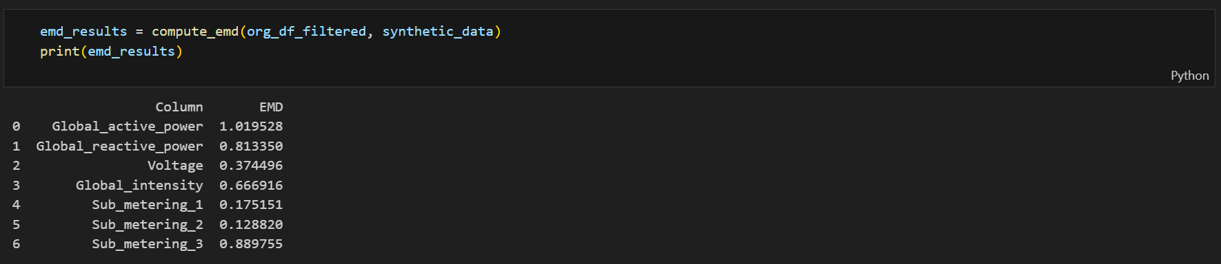
Earth Mover’s Distance :

Slide 50
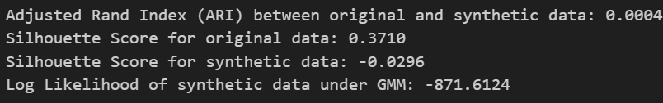
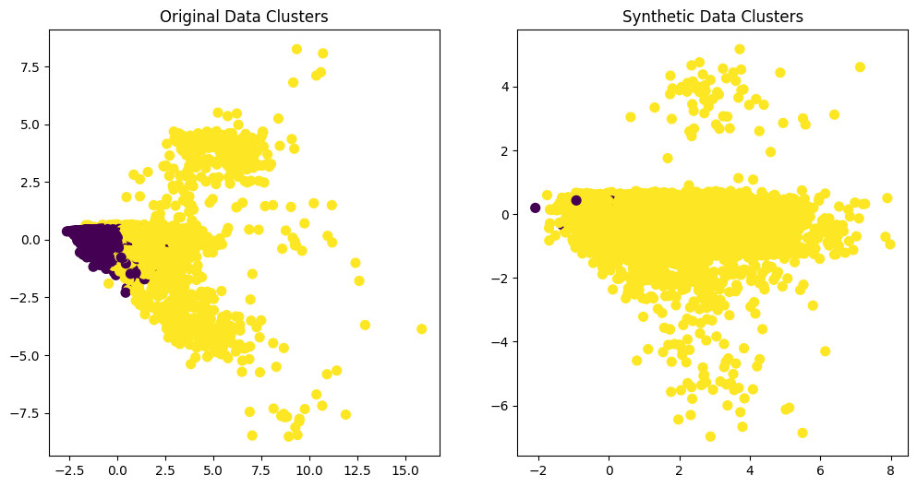
GMM Classifier :

Slide 51
Inference and Visualization for Model 4:

Slide 52
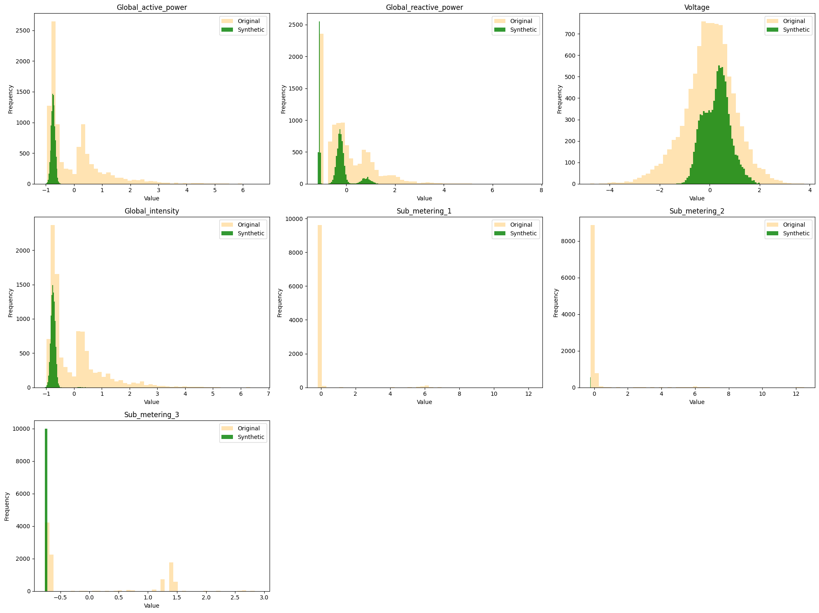
Histogram Plot

Slide 53

KDE Plot

Slide 54

Statistical Test:
KS Test(Kolmogorov Smirnov)

Slide 55

Summary Statistics Test:

Slide 56

Earth Mover’s Distance :

Slide 57


GMM Classifier :

Slide 58
References
GAN: I. Goodfellow, J. Pouget-Abadie, M. Mirza, B. Xu, D. Warde-Farley, S. Ozair, ... & Y. Bengio, "Generative adversarial nets," Advances in Neural Information Processing Systems, vol. 27, pp. 2672-2680, 2014
VAE: Kingma, D. P., & Welling, M. (2013). Auto-Encoding Variational Bayes. arXiv:1312.6114.
CTGAN and TVAE: L. Xu, A. Cuesta-Infante, M. Skoularidou, and K. Veeramachaneni, "Modeling tabular data using conditional GAN," arXiv preprint arXiv:1907.00503v2, 2019.
DDPMs: A. Kotelnikov, D. Baranchuk, I. Rubachev, and A. Babenko, "TabDDPM: Modeling tabular data with diffusion models," arXiv preprint arXiv:2204.06723, 2022.

